Slide 1

Intelligent Traffic Management System
Students Inc.

Slide 2
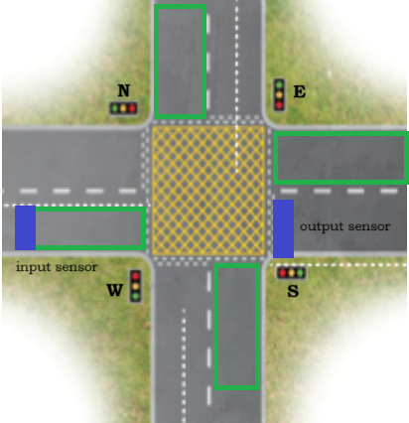
System Overview
Modular system of nodes
Each node manages single lane
Decentralized

Slide 3
Delivery: System structure and behaviour
Revised scenarios from use case
Concretisation of scenarios
Realisation of states of node: flag system

Slide 4
System behaviour
CurrentNode
NextNode
F
F

Slide 5
System behaviour
CurrentNode
NextNode
W
F

Slide 6
System behaviour
CurrentNode
NextNode
W
N

Slide 7
System behaviour
CurrentNode
NextNode
F
N

Slide 8
System behaviour
CurrentNode
NextNode
N
F

Slide 9
Delivery: Talking Skeleton
Wireless mesh
Protocol: ESPNow

Slide 10
Demo: Talking Skeleton

Slide 11
Next sprint planning
Part I: Realization of robust design, programming
Part II: Testing of procedures and Proof-of-concept realization

